Slide 1
BIOFERTILIZERS
Biofertilizers are defined as preparations containing living cells or latent cells of efficient strains of microorganisms that help crop plants uptake of nutrients by their interactions in the rhizosphere when applied through seed or soil. They accelerate certain microbial processes in the soil which augment the extent of availability of nutrients in a form easily assimilated by plants.
Use of biofertilizers is one of the important components of integrated nutrient management, as they are cost effective and renewable source of plant nutrients to supplement the chemical fertilizers for sustainable agriculture. Several microorganisms and their association with crop plants are being exploited in the production of biofertilizers. They can be grouped in different ways based on their nature and function.
I. N₂ fixers
a. Free living :
Aerobic – Azotobacter, Beijerinckia, Anabaena
Anaerobic – Clostridium
Faultative anaerobic – Klebsiella
b. Symbiotic
: Rhizobium, Frankia, Anabaena azollae
c. Associative symbiotic
: Azospirillum
d. Endophytic
: Gluconacetobacter Burkholdria
II. Phosphorus solubilizers
Bacteria
: Bacillus megaterium var. phosphaticum
B. subtilis, B. circulans Pseudomonas striata
Fungi
: Penicillium sp.
Aspergillus awamori
III. P mobilizers
AM fungi
Ectomycorrhizal fungi
Ericoid Mycorrhiza
Orchid mycorrhiza
Silicate and Zinc solubilizers: Bacillus sp,
Plant growth promoting Rhizobacteria: Pseudomans spp.,and many more

Slide 2
Importance of Biofertilizers
Biofertilizers are known to make a number of positive contributions in agriculture.
Supplement fertilizer supplies for meeting the nutrient needs of crops.
Add 20 – 200 kg N/ha (by fixation) under optimum conditions and solubilise/mobilise 30-50 kg P₂O₅/ha.
They liberate growth promoting substances and vitamins and help to maintain soil fertility.
They suppress the incidence of pathogens and control diseases.
Increase the crop yield by 10-50%. N₂ fixers reduce depletion of soil nutrients and provide sustainability to the farming system.
Cheaper, pollution free and based on renewable energy sources.
They improve soil physical properties, tilth and soil health.
1. Rhizobium
Rhizobia are soil bacteria, live freely in soil and in the root region of both leguminous and non-leguminous plants. However they enter into symbiosis only with leguminous plants, by infesting their roots and forming nodules on them. Non legume nodulated by Rhizobia is Trema or Parasponia sp.
The nodulated legumes contribute a good deal to the amount of N₂ fixed in the biosphere, (50-200 kg N/ha) varied with crops.
Clover - 130 kg N/ha
Cowpea - 62 – 128 kg N/ha
Beijerinck first isolated and cultivate a microorganism from the roots of legumes in 1888 and he named this as Bacillus radicola and latter modified as Rhizobium.
Legume plants fix and utilise this N by working symbiotically with Rhizobium in nodules on their roots. The host plants provide a home for bacteria and energy to fix atmospheric N₂ and in turn the plant receives fixed N₂ (as protein).
Cross inoculation group (CGI)
It refers the group of leguminous plant that will develop nodules when inoculated with the rhizobia obtained from the nodules from any member of that legume group.
Genera/species | Principal and other reported hosts
Rhizobium
R.etli | Phaseolus vulgaris, Mimosa affinis

Slide 3
R.galegae | Galega orientalis, G.officinalis
R.gallicum | Phaseolus vulgaris, Leucaena, Macroptilium, Onobrychis
R.giardini | Phaseolus vulgaris, Leucaena, Macroptilium
R.hainanense | Desmodium sinuatum, Stylosanthes, Vigna, Arachis, Centrosema
R.huautlense | Sesbania herbacea
R.indigoferae | Indigofera
R.leguminosarum bv trifolii bv viciae bv.phaseoli | Trifolium Lathyrus, Lens, Pisum, and Vicia, Phaseolus vulgaris
R.mongolense | Medicago ruthenica, Phaseolus vulgaris
R.sullae | Hedysarum coronarium
R.tropici | Phaseolus vulgaris, Dalea, Leucaena, Macroptilium, Onobrychis
Mesorhizobium
M.amorphae | Amorpha fruticosa
M.chacoense | Prosopis alba
M.ciceri | Cicer arietinum
M.huakuii | Astragalus sinicus, Acacia
M.loti | Lotus corniculatus
M. mediterraneum | Cicer arietinum
M.plurifarium | Acacia senegal, Prosopis juriflora, Leucaena
M.tianshanense | Glycyrrhiza pallidflora, Swansonia, Glycine, Caragana, Sophora
Sinorhizobium
S.abri | Abrus precatorius
S.americanus | Acacia spp.
S.arboris | Acacia senegal, Prosopis chilensis
S.fredi | Glycine max
S.indiaense | Sesbania rostrata
S.kostiense | Acacia senegal, Prosopis chilensis
S.kummerowiae | Kummerowia stipulacea
S.meliloti | Medicago, Melilotus, Trigonella

Slide 4
S.medicae | Medicago truncatula, M. polymorpha, M.orbicularis
S.morelense | Leucaena leucocephala
S.sahelense | Acacia, Sesbania
S.terangae | Acacia, Sesbania
Azorhizobium
A.caulinodans | Sesbania rostrata
Allorhizobium
A.undicola | Neptunia natans, Acacia, Faidherbia, Lotus
Bradyrhizobium
B.elkanii | Glycine max
B.japonicum | Glycine max
B.liaoningense | Glycine max
B.yuanmingense | Lespedeza, Medicago, Melilotus
Description and characteristics Classification
1. Family : Rhizobiaceae
2. Genus
: Azorhizobium-for stem nodulation
Bradyrhizobium Rhizobium Sinorhizobium
Morphology
Unicellular, cell size less than 2µ wide, short to medium rod, pleomorphic.
Motile with Peritrichous flagella
Gram negative
Accumulate PHB granules.
Physiology
1. Nature
: Chemoheterotrophic, symbiotic with legume
: Supplied by legume through photosynthates, monosaccharides, disaccharide
2. C source
3. N source
: Fixed atmospheric N₂

Slide 5
4. Respiration
: Aerobic
5. Growth
: Fast (Rhizobium), slow (Bradyrhizobium)
: Fast growers – Slow growers – 6-12 hrs
6. Doubling time
2-4
hrs
7. Growth media
: YEMA
Contribution
Direct contribution of N symbiotically with legumes.
Residual nitrogen benefit for the succeeding crop.
Yield increase is by 10-35%.
Improve soil structure.
Produces exopolysaccharides.
Produces plant growth hormone.
Recommended for legumes (Pulses, oilseeds, fodders)
Promising strains: NGR 6, NC 92, CC 1, CRR 6, CRU 14, COBE 13.
2. Azotobacter
It is a free living N₂ fixer, the cells are not prevent on the rhizoplane, but are abundant in the rhizosphere region. It is classified under the family Azotobacteriaceae. It requires more of organic matter and depend on the energy derived from the degradation of plant residues. Beijerinck was the first to isolate and describe Azotobacter.
Species
Cell size, flagellation, pigmentation and production of extracellular slime are considered as diagnostic features of these bacteria in distinguishing species.
A. chroococcum : Black to brown insoluble pigment.
A. vinelandii, A. paspali, : Green fluorescent and soluble pigments
A. agilis
A. beijerinckii : Yellow to light brown insoluble pigments
A. macrocytogenes : Pink soluble pigments
A. insignis : Yellow brown pigments

Slide 6
Azotobacter cells are polymorphic, gram negative, form cyst and accumulate Poly Beta hydroxy butyric acid and produces abundant gum.
Morphology
Cell size : Large ovoid cells, size 2.0 – 7.0 x 1.0 – 2.5 µ
Cell character : Polymorphic
Gram character : Negative
Physiology
Nature : Chemoheterotrophic, free living
C source : Mono, di saccharides, organic acids
N source : N₂ through fixation, amino acids, NH₄⁺, NO₃⁻
Respiration : Aerobic
Growth : Ashby / Jensen's medium
Doubling time : 3 hours
Benefits
Ability to fix atmospheric N₂ – 20-40 mg BNF/g of C source in laboratory equivalent to 20-40 kg N/ha.
Production of growth promoting substances like vitamin B, Indole acetic acid, GA.
Ability to produce thiamine, riboflavin, pyridoxin, cyanogobalanine, nicotinic acid, pantothenic acid, etc.
Biological control of plant diseases by suppressing Aspergillus, Fusarium.
- Recommended for Rice, wheat, millets, cereals, cotton, vegetables, sunflower, mustard and flowers.
3. Azospirillum
Azospirillum was I isolated by Beijerinck (1922) in Brazil from the roots of Paspalum and named it as Azotobacter paspali and later named as Spirillum lipoferum. Dobereiner and Day (1976) reported the nitrogen fixing potential of some forage grasses due to the activity of S. lipoferum in their roots. Dobereiner coined the term "Associative symbiosis" to denote the occurrence of N₂ fixing spirillum in plants. Taxonomy was re-examined and Tarrand et al. (1978) designated this organism as Azospirillum.

Slide 7
It is an aerobic or micro aerophilic, motile, gram negative bacterium. Non spore former and spiral shaped bacterium, inhabiting the plant roots both externally and internally. Being a micro aerophilic organism, it can be isolated on a semi solid malate medium by enrichment procedures.
Classification
Species: (7) Family – Spirillaceae
A. brasilense
A. lipoferum
A. amazonense
A. halopraeferens
A. irkense
A. dobereinerae
A. largimobilis
Morphology
1. Cell size
: Curved rods, 1 mm dia, size and shape vary
2. Accumulate
: PHB
3. Gram reaction
: Negative
4. Development of white pellicles : 2-4 mm below the surface of NFB medium
Physiology
Nature : Chemoheterotrophic, associative
Sole carbon source : Organic acids, L-arabinose, D-gluconate,
D-fructose, D-glucose, sucrose, Pectin
N source :
Respiration :
Growth media :
Doubling time :
N₂ through fixation, amino acids, N₂, NH₄⁺, NO₃⁻
Aerobic, Microaerophilic
NFBTB (NFB) medium
1 hr in ammonia containing medium
5.5 – 7.0 hrs in malate containing semisolid medium
Mechanism of Action
Contribution by BNF
Production of PGP substances by bacteria
– Increases root hair development, biomass.

Slide 8
Production of PGP substances by plant
  Morphological changes in root cells.
  Increased activity of IAA oxidase
  Increase in endogenous IAA
  Increased mineral and water uptake, root development, vegetative growth and crop yield.
Competition in the rhizosphere with other harmful microorganism.
Polyamines and amino acids production.
Increased extrusion of protons and organic acids in plants.
Benefits
Promotes plant growth.
Increased mineral and water uptake, root development, vegetative growth and crop yield.
Inoculation reduced the use of chemical fertilizers (20-50%, 20-40 kg N/ha)
Increases cost benefit ratio.
Reduces pathogen damage.
Inhibit germination of parasitic weeds.
Restoration of arid zone, margine mangrove ecosystem.
Reduces humic acid toxicity in compost.
- Recommended for rice, millets, maize, wheat, sorghum, sugarcane and co-inoculant for legumes.
4. Gluconacetobacter diazotrophicus
It is an endophytic N₂ fixer and form to occur on large numbers in roots, stem and leaf of sugarcane and other sugar rich crops. It was first isolated from sugarcane. Cavalcanti and Dobereiner (1988) reported this new endophytic N₂ fixer and recently called as from G. diazotrophicus. It can tolerate upto 30% sucrose concentration and pH upto 3.0. Optimum sucrose concentration is 10-15%.
Produce surface yellow pellicle on semisolid medium. Does not grow at pH 7.0.
Optimum is 5.5.
Benefits
Fixes atmospheric N₂
Production of PG hormones (GA, DAA is double than Azospirillum).
Suitable for sugar rich crops with acidic pH.

Slide 9
5. Azorhizobium
These genera can produce stem nodules. Stem nodulation has been reported in 3 genera of legumes: Aeschynomene, Neptunia and Sesbania.
Stem nodulating Rhizobium comprises both fast and slow growing types having the generation time of 3-4 hr and 10 hrs respectively. Those nodulate Aeschynone can cross inoculate with S. rostrata strains Azorhizobium caulinodans.
fix N₂ in free living conditions without differentiating into bacteroids.
have O₂ protection mechanisms, to fix N₂ under free living conditions.
Mode of entry is through lateral root cracks. No infection thread is formed during colonization.
Form both stem and root nodules in S. rostrata.
Gram negative, motile rods.
Produces root nodules in rice, wheat.
Algal Biofertilizers
The agronomic potential of cyanobacterial N₂ fixation in rice fields was recognised in India during 1939 by De who attributed the natural fertility of tropical rice fields to N₂ fixing blue green algae. The rice field ecosystem provides an environment favourable for the growth of blue green algae with respect to their requirements for light, water, high temperature and nutrient availability.
Algal biofertilizers constitutes a perpetual source of nutrients and they do not contaminate ground water and deplete the resources. In addition to contributing 25-30 kg N ha⁻¹ of biologically fixed N₂, they can also add organic matter to the soil, excrete growth promoting substances, solubilises insoluble phosphates and amend the physical and chemical properties of the soil.
Blue green algae are a group of prokaryotic, photo synthetic microscopic plants, vigorously named as Myxophyceae, Cyanophyceae and Cyanobacteria. They show striking morphological and physiological similarities like bacteria and hence called as cyanobacteria. Cyanobacteria
They are the photosynthetic bacteria and some of them are able to fix N₂. They can be divided into two major groups based on growth habit.
  Unicellular forms and
  Filamentous forms.
N₂ fixing species are from both groups, found in paddy fields, but the predominant ones are the heterocystous filamentous forms.

Slide 10
Cyanobacteria are not restricted to permanently wet habitats, as they are resistant to desiccation and hot temperatures, and can be abundant in upland soils. However wet paddy soils and overlying flood waters provide an ideal environment for them to grow and fix N₂.
Natural distribution
BGA are cosmopolitan in distribution and more widely distributed in tropical zone. Free living cyanobacteria can grow epiphytically on aquatic and emergent plant as well as in flood water or on the soil surface. Heterocystous cyanobacteria formed less than 10% of the population of eukaryotic green algae and the abundance increased with the amount of available phosphorus and with the pH value over the range 4 – 6.5. In rice soil, population ranges from 10 – 10⁷ cfu g⁻¹ soil.
The main taxa of N₂ fixing cyanobacteria
Group | Genera | DNA (mol % GC)
Group-I. Unicelluar: single cells or cell aggregates | Gloeothece, Gloeobacter,Synechococcus, Cyanothece, Gloeocapsa, Synechocystis, Chamaesiphon, Merismopedia | 35-71
Group-II. Pleurocapsalean: reproduce by formation of small spherical cells called baeocytes produced through multiple fission. | Dermocarpa, Xenococcus, Dermocarpella, Pleurocapsa, Myxosarcina, Chroococcidiopsis | 40-46
Group-III. Oscillatorian: filamentous cells that divide by binary fission in a single plane. | Oscillatoria, Spirulina, Arthrospira, Lyngbya, Microcoleus, Pseudanabaena. | 40-67
Group-IV. Nostocalean: filamentous cells that produce heterocysts | Anabaena, Nostoc, Calothrix, Nodularia, Cylinodrosperum, Scytonema | 38-46
Group-V.Branching: cells divide to form branches | Fischerella, Stigonema, Chlorogloeopsis, Hapalosiphon | 42-46
The N₂ fixing forms generally have a specialized structure known as heterocyst. The BGA have minimum growth requirement needing only diffused light, simple inorganic

Slide 11
nutrients and moisture. The heterocysts which are modified vegetative cells, because of their thick walls and absence of photonactin II in photosynthesis, act as ideal sites for N₂ fixation under aerobic conditions. Although the nitrogenase is present in vegetative cells, it remains inactive because of the presence of oxygenic photosynthesis. They built up natural fertility (C, N) in soil.
N₂ fixing BGA: Anabaena, Nostoc, Cylindrospermum, Tolypothrix, Calothrix, Scytonema, Westiellopsis belonging to orders Nostocales and Stignematales. Many non-heterocystous forms are also fix N₂. eg: But need microaerobic or anaerobic conditions. Gleocapsa fix in aerobic condition.
The species of BGA, known to fix atmospheric N₂ are grouped as 3 groups.
(i)
Heterocystous – aerobic forms
(ii)
Aerobic unicellular forms
(iii)
Non-heterocystous, filamentous, micro aerophilic forms.
The blue green algal culture's composite inoculum consists of Nostoc, Anabaena,
Calothrix, Tolypothrix, Plectonema, Aphanotleca, Gleocapsa, Oscillatoria, Cylindrospermum, Aulosira and Scytonema.
Contributions of algal biofertilizer
Important component organic farming.
Contribute 20 – 25 kg N ha⁻¹.
Add organic matter to the soil.
Excrete growth promoting substances.
Solubilize insoluble phosphates.
Improve fertilizer use efficiency of crop plants.
Improve physical and chemical properties of soil.
Reduce C:N ratio.
Increase the rice yield by 25-30%.
Cyanobacteria are more compatible with nitrate N than ammonium N.
It increases FUE of the crop plants through exudation of growth promoting substances and preventing a part of applied fertilizer N from being lost.

Slide 12
Phosphobacteria and Mycorrhizae
Phosphate solubilising Microorganisms Introduction
Though most soils contain appreciable amounts of inorganic P, most of it being insoluble forms, cannot be utilized by crops unless they are solubilzied. Soils also contain organic P that could not be utilized by plants only when it is mineralized. Phosphate solubilizing microorganisms not only able to solubilize insoluble forms of inorganic P but are also capable to mineralize organic forms of P, thus improving the availability of native soil P making their P available to plants. PSM can also solubilize P from rock phosphate (RP), slag or bone meal making their P available to plants.
Thus PSM biofertilizer being economical and environmentally safe offers a viable alternative to chemical fertilizers.
Microorganisms involved
Many microorganisms can solubilize inorganic phosphates, which are largely unavailable to plants. Microbial involvement in solubilization of inorganic phosphate was first shown by Stalstron (1903) and Sacket et al. (1908) gave conclusive evidence for bacterial solubilization of RP, bonemeal and TCP.
Various bacteria and fungi reported to solubilize different types of insoluble phosphates. Not only solubilizes but also mineralize organic P compounds and release orthophosphates.
In general PSM constitute 0.5 – 1.0% of soil microbial population with bacteria and out numbers the fungi by 2 – 150 folds. But bacteria may loose the P solubilizing ability while sub culturing and fungi do not lose. Among bacteria, aerobic spore forming bacteria are more effective P solubilizers.
Mechanism of PO₄ solubilization
Different mechanisms were suggested for the solubilization of inorganic phosphates.
  Production of organic acids
  Chelating effect
  Production of inorganic acids
  Hydrogen sulphide production (H₂S)
  Effect of carbon dioxide
  Proton extrution
  Siderophore production

Slide 13
Siderophores, bind iron tightly to prohibit its reaction with soluble phosphate and rather help release PO₄ fixed as ferric phosphate. It is important in acid soils, where ferric PO₄ is one of the major forms.
The extent of PO₄ solubilization depends on the type of organisms involved. The genus Bacillus showed maximum activity followed by Penicillium and Aspergillus. Streptomyces was least effective.
A. awamori & A. niger, Bacillus polymixa & Penicillium striata are effective in solubilization of phosphate solubilizarion
Mycorrhizae
Mycorrhiza (fungus root) is the mutualistic association between plant roots and fungal mycelia. Frank (1885) gave the name "mycorrhiza" to the peculiar association between tree roots and ectomycorrhizal fungi. 95% of the plant species form mycorrhizae. It can act as a critical linkage between plant roots and soil. This association is characterized by the movement of plant produced carbon to fungus and fungal acquired nutrients to plants. Mycorrhizal fungi are the key components of the rhizosphere are considered to have important roles in natural and managed ecosystems.
Types of mycorrhiza
Mycorrhizal associations vary widely in structure and function. Two main groups of mycorrhizae are recognized; the ectomycorrhizae and endomycorrhizae, although the rare group with intermediate properties, the ectendotrophic mycorrhizae.
  Ectomycorrhiza
The fungal hyphae form a mantle both outside the root and within the root in the intercellular spaces of the epidermis and cortex. No intracellular penetration into epidermal or cortical cells occurs, but an extensive network called the Hartignet is formed between these cells. Sheath or Mantle increases the surface area of absorbing roots and offers protection to the roots. Hartignet can act as storage and transport organ for P.
Ectomycorrhizae are common on trees, including members of the families pinaceae (Pin, Fir, Spruce, Larch, Semlock), Fagaceae (Willow, Poplar, Chesnut), Betulaceae (Birch, Alder), Salicaceae (Willow, Poplar) and Myrtaceae.
The fungi forming Ectomycorrhizal association are coming under Basidiomycotina and Ascomycotina. eg: Laccaria laccata, Suillus, Rhizopogan, Amanita
  Endomycorrhizae
Endomycorrhizae consist of three sub groups, but by far the most common are the Arbuscular Mycorrhizal fungi. Fungi under AM are the members of Endogonaceae and they produce an internal network of hyphae between cortical cells that extends out into the soil,

Slide 14
where the hyphae absorb mineral salts and water. This fungus do not form an external mantle but lives within the root. In all forms, hyphae runs between and inside the root cells which includes,
Ericoid mycorrhiza - Associated with some species of Ericaceous plants
Orchid mycorrhiza - associated with orchid plants
Arbuscular mycorrhiza - associated with most of the plant families
Arbuscular Mycorrhizal fungi The most important one is AM
AM, an endomorphic mycorrhizae formed by the aseptate phycomycetous fungi are associated with majority of agricultural crops, growing under broad ecological range.
Class : Zygomycotina
Order : Endogonales
Family : Endogonaceae 150 species of AMF are known.
Colonization Process
Roots do not show visual morphological changes due to AM colonization. AM fungal infection into a host occurs by germination of spore, hyphal growth through soil to host roots, penetration of host roots and spread of infection inter and intracellularly in the root cortex. Colonization occurs under two phases: (1) Extra matrical phase and (2) Intra radical phase.
Extra matrical phase: Events occurring outside the root after the germination of chlamydospores. Mycelium explores larger soil volume. Fungal growth can be 80-130 times the length of root. Extra matrical hyphae (EMH) are larger in diameter than inner hyphae. Once the fungus recognises the plant, appresorium is formed in the host roots and penetration occurs via the appresorium. EMH ends with resting spores in soil.
Intra radical phase: Events occurring inside the root cortex. After penetrating the cortex, the fungus may produce intercellular as well as intracellular hyphae in the cortical cells. Forms two morphological structures namely arbuscules and vesicles inside the cortical cells. Arbuscules: are the first formed structures after the hyphal entry into the cortical cells. Arbuscules are the fine dichotomously branched hyphal filaments look like little trees. Arbuscules start to form approximately 2 days after penetration. They are considered as the

Slide 15

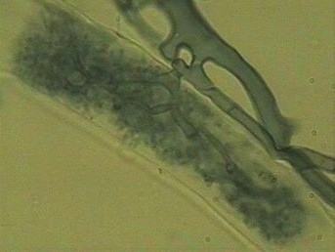
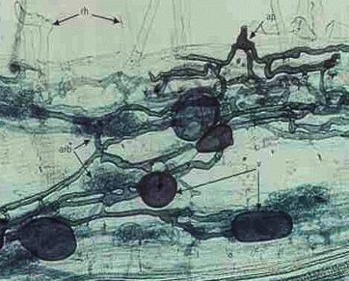

major site of exchange between the fungus and host root. They are short lived (4-13 days) and degenerate.
Vesicles: Following the formation of arbuscules, some species of fungi also form vesicles in the roots. Terminal or intercallery hyphal swellings of the hyphae called vesicles. Vesicles contain lipids and cytoplasm. They act as P storage organ and they ever be present in the root. Size of the vesicles is about 30-100 µm. In vesicles P can be accumulated as polyphosphates.
EMH, vesicles and Arbuscules play a key role in nutrient transfer particularly in mobilisation of phosphorus.
Mechanism of action
The beneficial effect on plant growth and yields following inoculation with VAM is attributed to
improved mineral nutrition, especially P (P, Zn, Cu, K, S, NH₄)
Mobilization of nutrients through greater soil exploration.
Protection of host roots against pathogen infection.
Improved water relation
Better tolerance to stress like salinity, heavy metal pollution
Protection against transplantation shock.
Continued…..
Arbuscules
vesicles.

Slide 16
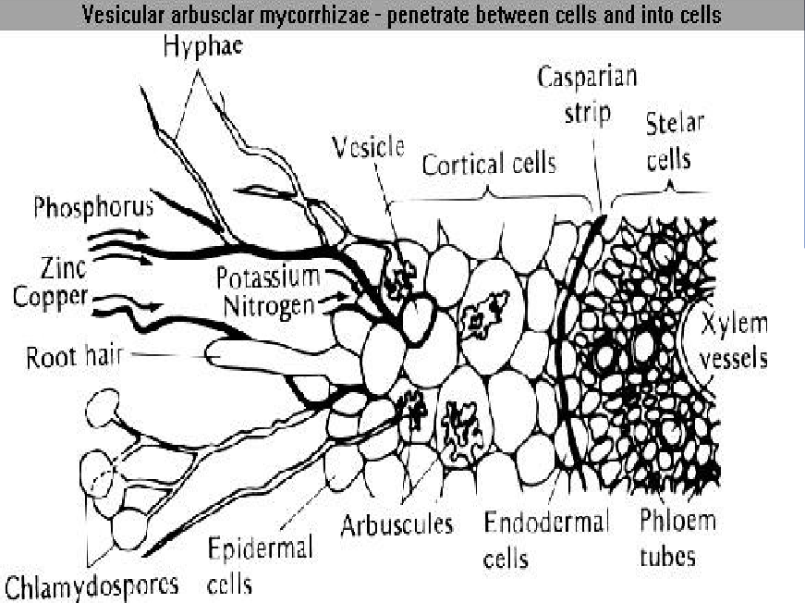



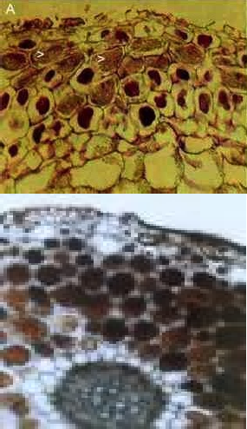
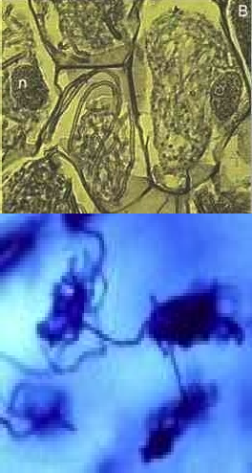

stained masses of fungal hyphae (arrowheads).
cells of the orchid are filled with coils of fungal hyphae

Slide 17
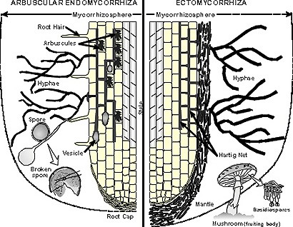
Reasons for Enhanced P uptake by AM Fungi
Physical exploration of soil.
Higher affinity towards P
Lower threshold concentration
Rhizosphere modification
Differences in anion and cation absorption due to exudation pattern.
Siderophore production.
Selective stimulation of microorganisms in the rhizosphere.
Increased hyphal area for absorption (EMH).
Absorb and transport P beyond the depletion zone around the root.
P absorption by EMH is 1000 times faster than normal hyphae and 3-4 times greater.
Disease resistance
Resist the parasitic invasion and minimises the loss.
Mycorrhizal roots harbour more actinomycetes.
Mycorrhizal roots have elevated levels of phenols, while offers resistance to fungal hydrolytic enzymes.
Mycorrhizal infection stimulates biosynthesis of phytoalexins.

